Slide 1
Micro Credit Loan Use Case

Slide 2
Contents
Problem Statement
Definition
Benefits of Customer Retention
EDA Steps
Visualizations
Analysis
Conclusion
Limitation

Slide 3
Problem Statement
Today, microfinance is widely accepted as a poverty-reduction tool, representing $70 billion in outstanding loans and a global outreach of 200 million clients.
We are working with one such client that is in Telecom Industry. They are a fixed wireless telecommunications network provider. They have launched various products and have developed its business and organization based on the budget operator model, offering better products at Lower Prices to all value conscious customers through a strategy of disruptive innovation that focuses on the subscriber.
They are collaborating with an MFI to provide micro-credit on mobile balances to be paid back in 5 days. The Consumer is believed to be defaulter if he deviates from the path of paying back the loaned amount within the time duration of 5 days. For the loan amount of 5 (in Indonesian Rupiah), payback amount should be 6 (in Indonesian Rupiah), while, for the loan amount of 10 (in Indonesian Rupiah), the payback amount should be 12 (in Indonesian Rupiah).
I have to make a model , which will predict in terms of a probability for each loan transaction, whether the customer will be paying back the loaned amount within 5 days of insurance of loan. In this case, Label ‘1’ indicates that the loan has been payed i.e. Non- defaulter, while, Label ‘0’ indicates that the loan has not been payed i.e. defaulter.

Slide 4
Definition
A Microfinance Institution (MFI) is an organization that offers financial services to low income populations. MFS becomes very useful when targeting especially the unbanked poor families living in remote areas with not much sources of income. The Microfinance services (MFS) provided by MFI are Group Loans, Agricultural Loans, Individual Business Loans and so on.
Many microfinance institutions (MFI), experts and donors are supporting the idea of using mobile financial services (MFS) which they feel are more convenient and efficient, and cost saving, than the traditional high-touch model used since long for the purpose of delivering microfinance services. Though, the MFI industry is primarily focusing on low income families and are very useful in such areas, the implementation of MFS has been uneven with both significant challenges and successes.
Today, microfinance is widely accepted as a poverty-reduction tool, representing $70 billion in outstanding loans and a global outreach of 200 million clients.

Slide 5
Benefits of Micro Credit Default Loan Use Case
Improved market penetration
Enhanced control over the distribution
Lower transaction failure rate
Better loyalty of resellers and subscribers
Revenue addition
Service continuation
Highly robust platform with strong support

Slide 6
Exploratory Data Analysis(EDA)
Imported necessary libraries and loaded the dataset.
Checked null values. There is not any null value.
Done feature engineering for column pdate, extract day ,month and year.
Formatted column msisdn(mobile number of the user),Length is 11,at every 6th place alphabet I
Found.
5.Performed both univariate and bivariate analysis and visualized each feature using seaborn and matplotlib libraries by plotting count plot, scatter plot, dist plot, and box plots.

Slide 7
Data and Assumptions
The given data contains 209593 rows and 37 columns.
Columns given and their description are as follows:
1.Label-Flag indicating whether the user paid back the credit amount within 5 days of issuing the loan{1:success, 0:failure}
2. Mobile Number, Age on Cellular Network in days, telecom circle and date are given.
3. Some of the columns have information regarding number of days till last recharge of main account and data account.
4. Daily amount spent from main account ,averaged over last 30 days and in last 90 days given. Amount is in Indonesian Rupiah.
5.Average main account balance over last 30 days and in last 90 days given.
6.Frequency of main account recharged in last 30 days and in last 90 days given.
7. Number of times main account and data account got recharged in last 30 days and in last 90 days are given.
8

Slide 8
Data and Assumptions continued
8.Number of loans and Amount of loans taken in last 30 days and in last 90 days given.
9.Maximum amount of loan taken in last 30 days and in last 90 days given.
10.Average payback time in days over last 30 days and in last 90 days given.
11.Median of amount of recharges done in main account over last 30 days and over last 90 days are given.
12.Median of main account balance just before recharge in last 30 days and in last 90 days are given.
Assumption :- If Customer pays back the amount of loan taken within 5 days, So He falls into the category of Non Defaulter also gain trust of the loan giving company and will get easily loan next time.

Slide 9
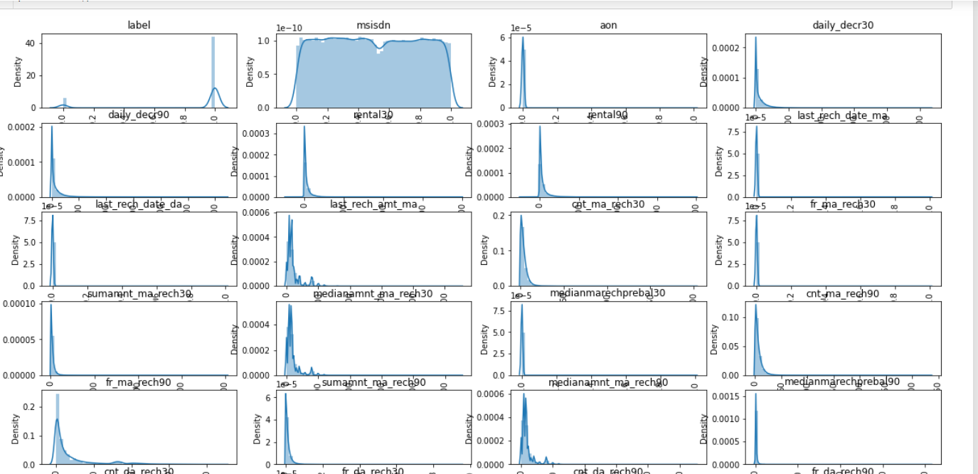
Visualization
Data Analysis : - Almost all the column's data rightly skewed, means outliers are present in almost all columns.

Slide 10
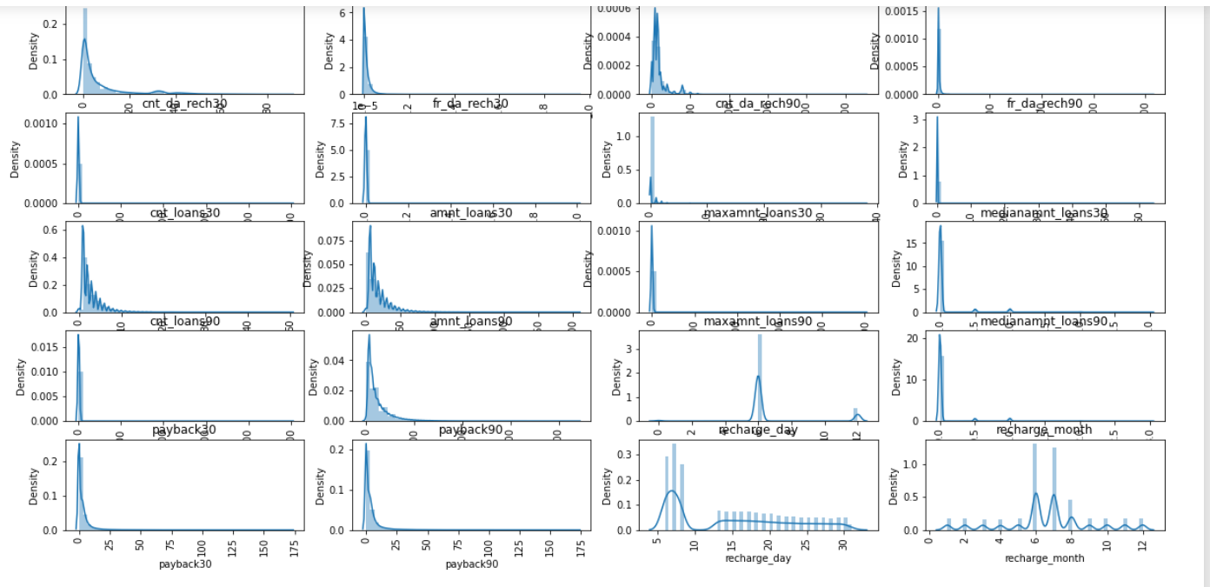
Visualization
Data Analysis :- Data is not normally distributed and very much skewed.

Slide 11
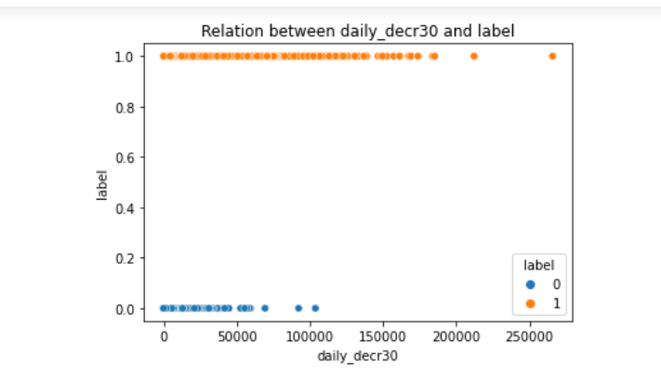
Visualization
Data Analysis : Non Defaulter customer's(label with 1) daily amount spent from main account(averaged over last 30 days) ranges mostly from 0 to approx. 1,70000 rupiah, where as Defaulter customer's daily amount spent from main account is from 0 to approx. 70,000 rupiah.

Slide 12
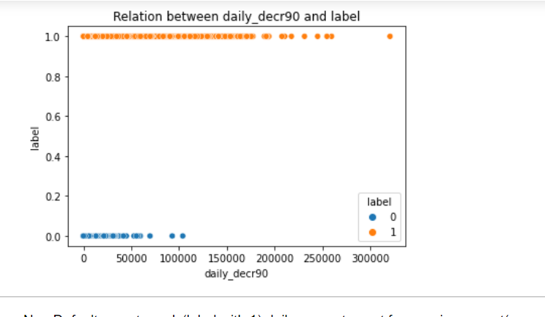
Visualization
Data Analysis : Non Defaulter customer's(label with 1) daily amount spent from main account(averaged over last 90 days) ranges mostly from 0 to approx.2,20000 rupiah, where as Defaulter customer's daily amount spent from main account is from 0 to approx. 70,000 rupiah.

Slide 13
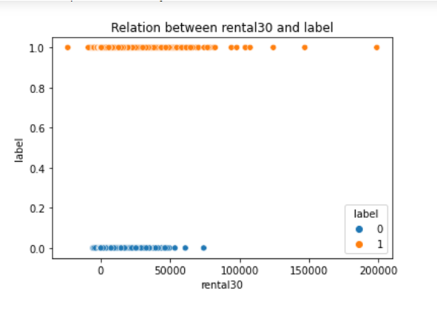
Visualization
Data analysis : Non Defaulter customer's(label with 1) average main account balance( over last 30 days) ranges mostly from 0 to approx. 1,20000 rupiah, where as Defaulter customer's average main account balance(over last 30 days) is from 0 to approx. 60,000 rupiah. Outliers are also present in the dataset.

Slide 14
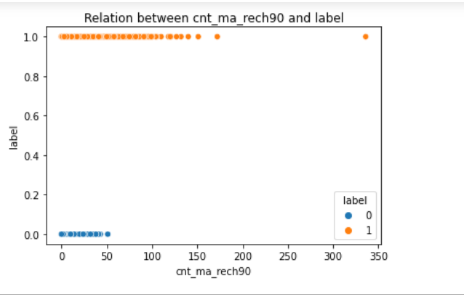
Visualization
Data Analysis : Non Defaulter customer's(label with 1) Number of times main account got recharged in last 90 days is more than Defaulter customers number of times main account got recharged in last 90 days.

Slide 15
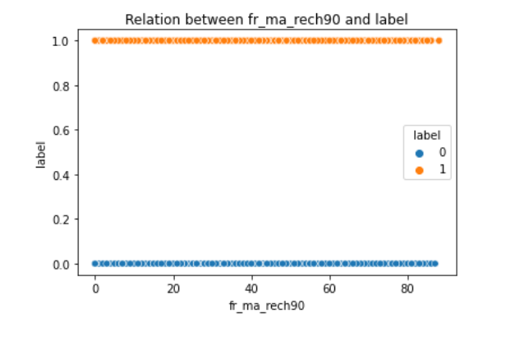
Visualization
Data Analysis :Non Defaulter customer's(label with 1) frequency of main account recharged in last 90 days is same as Defaulter customer's frequency of main account recharged in last 90 days.

Slide 16
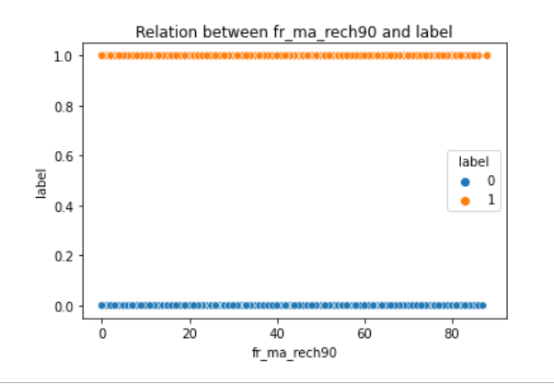
Visualization
Data Analysis : Non Defaulter customer's(label with 1) frequency of main account recharged in last 90 days is same as Defaulter customer's frequency of main account recharged in last 90 days.

Slide 17
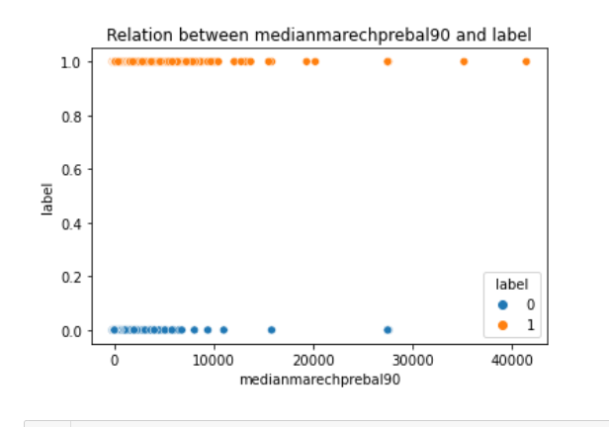
Visualization
Data Analysis : Non Defaulter customer's(label with 1) median of amount of recharges done in main account over last 90 days at user level (in Indonesian Rupiah) is more than Defaulter customer's Median of main account balance just before recharge in last 90 days at user level (in Indonesian Rupiah)

Slide 18
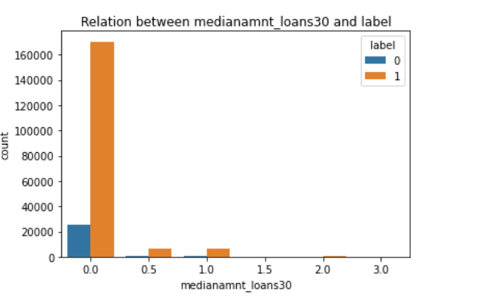
Visualization
Data Analysis : Non Defaulter customer's (label with 1) Median of amounts of loan taken by the user in last 30 days is more than defaulter customers.

Slide 19
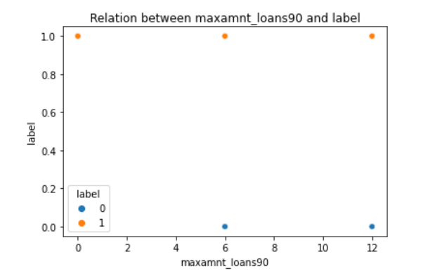
Visualization
Data Analysis: Non Defaulter customer's (label with 1) maximum amount of loan taken in last 90 days is same as defaulter customers. Maximum amount of loan is 6 and 12 rupiah.

Slide 20
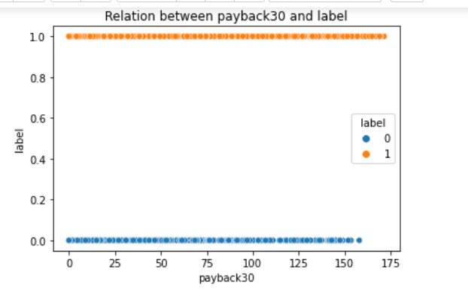
Visualization
Data Analysis : Non Defaulter customer’s (label with 1) count of average payback time in days over last 30 days is more than defaulter customers.

Slide 21
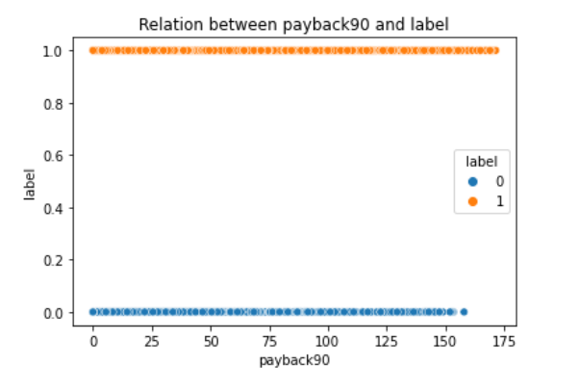
Visualization
Data Analysis : Non Defaulter customer's (label with 1) count of average payback time in days over last 90 days is more than defaulter customers.

Slide 22
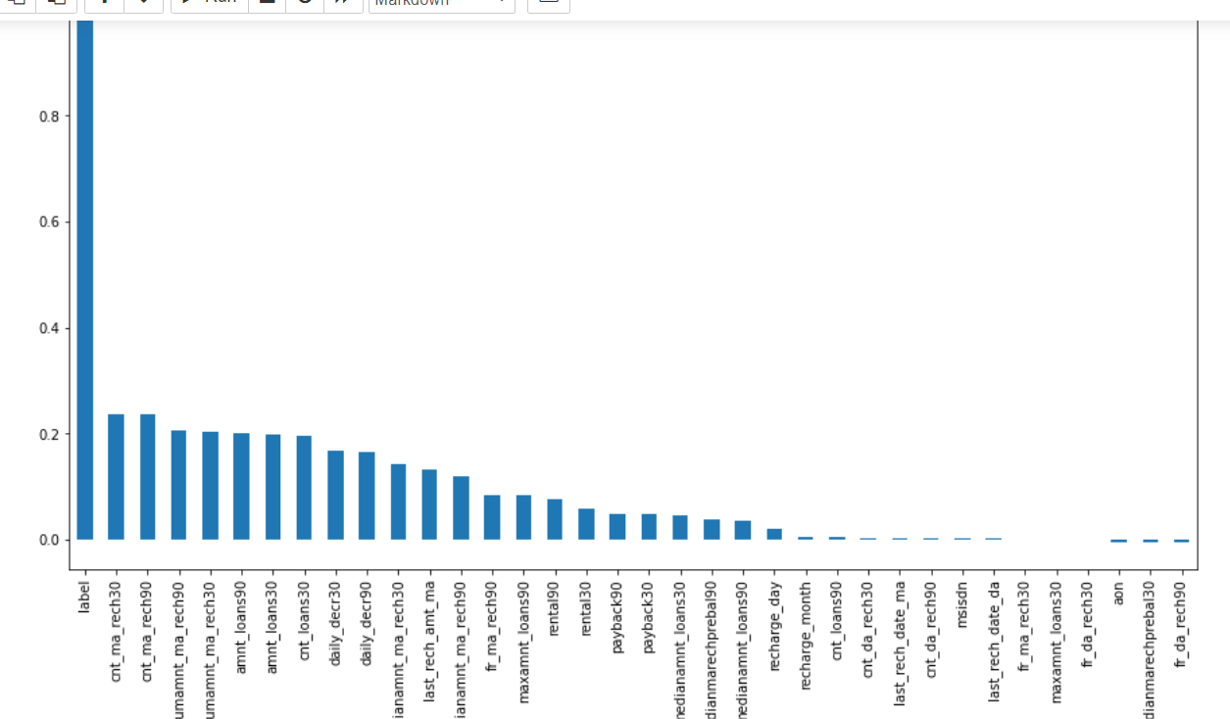
Correlation
Relation of features with label, Showing features are how much related with label.
So here we can see that Some of the features
Are very weakly correlated with label, and others have normal, not so strong relation with label.

Slide 23
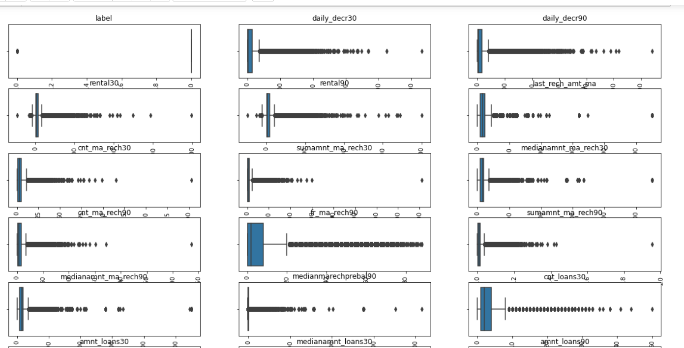
Outliers
Outliers detection using boxplot.

Slide 24
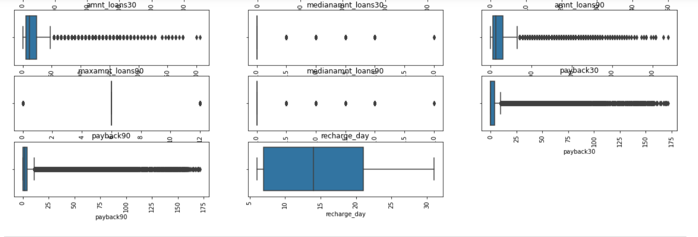
Outliers
Using boxplot, we can see that label,medianamnt_loans30,median_amnt_loans90,maxamnt_loans90, these are categorical columns, Except recharge_day, In every column, outliers are present.

Slide 25
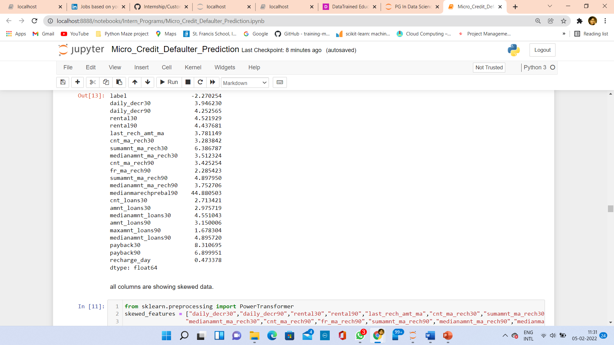
Skewness
As here, It is shown that almost every column’s data is skewed. So keeping range between +/- 3, I have removed skewness using PowerTransformer , and method is yeo-johnson.

Slide 26
Outlier Removal
I have removed outlier using zscore.
After removing outliers, data loss is about 7.8 %.

Slide 27
Standardization
To generalize/standardize our data, first I have splitted my data between features and label.
In our target data, data is not balanced.
So using SMOTE ,I have oversample target data, so that I’ll not loose any information.
I have generalized data using StandardScaler method.

Slide 28
Multicollinearity
I have checked multicollinearity using variance_inflation_factor.
Dropped those columns, whose values are greater than 10.

Slide 29
Model Building
Since our label data is binary(0 and 1), So it is a binary classifier.
I have chosen following classifiers to build model:
a)Logistic Regression
b)Random Forest
c)KNeighbors Classifier
d)AdaBoosting Classifier
e)DecisionTree Classifier
As we know that RandomForest, DecisionTree and AdaBoosting, these classifier models are insensitive to outliers. So I have chosen these models to build model.

Slide 30
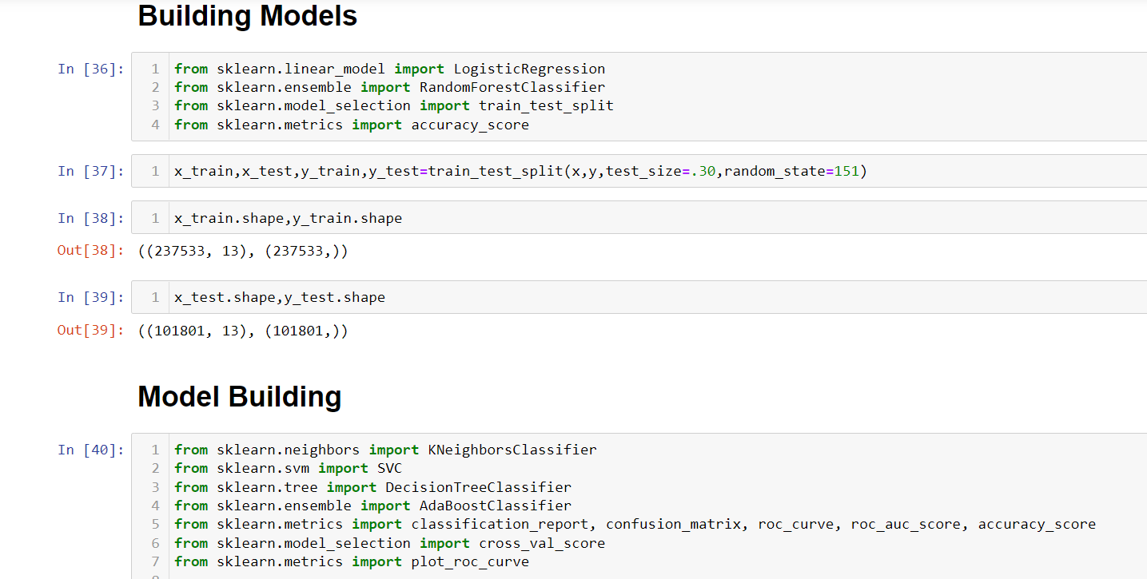
Train Test Split and Importing necessary libraries

Slide 31
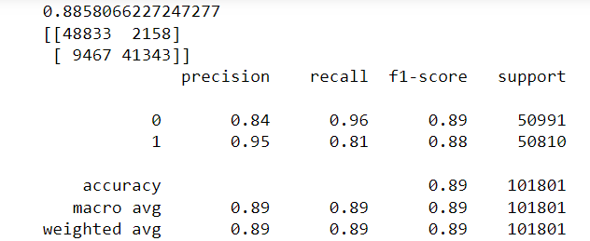
KNeighbors Classifier
Accuracy Score,f1 – score, precision, recall

Slide 32
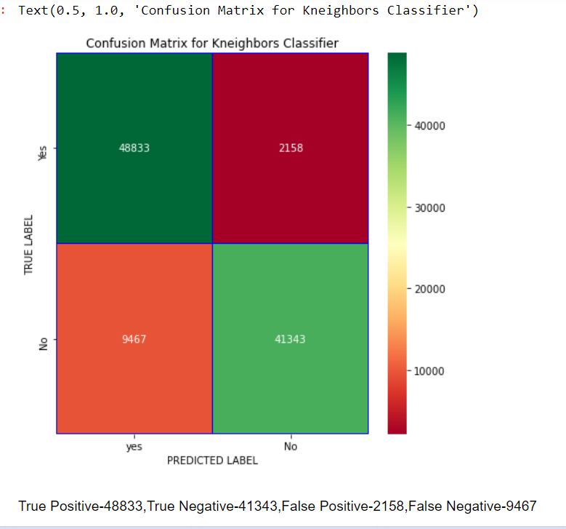
KNeighbors Classifier :Confusion Matrix

Slide 33
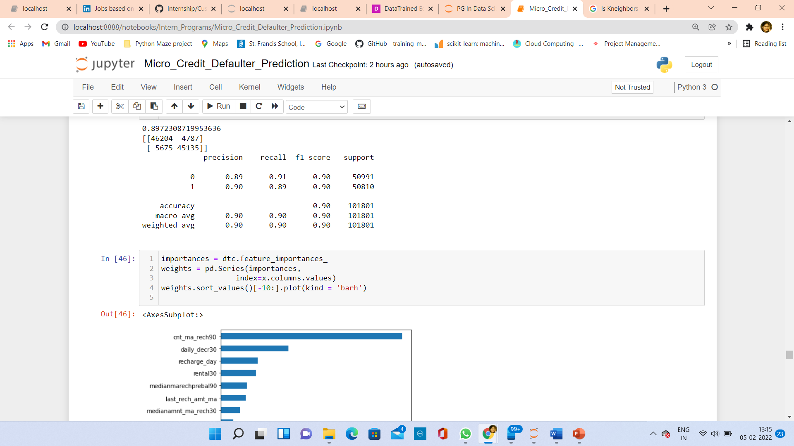
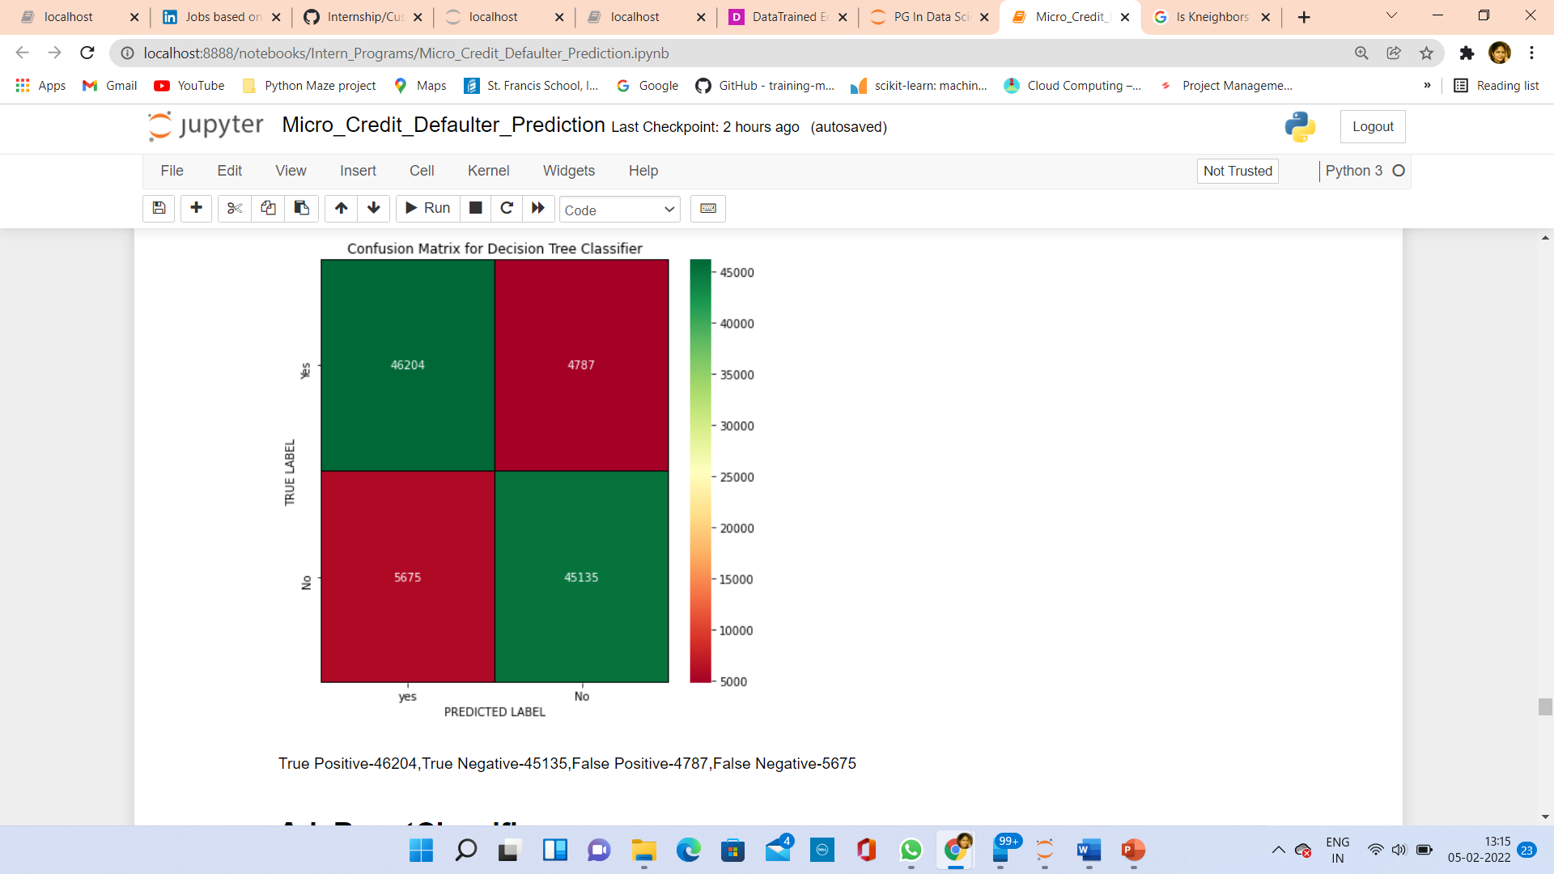
DecisionTree Classifier: Classification Report and Confusion Matrix

Slide 34
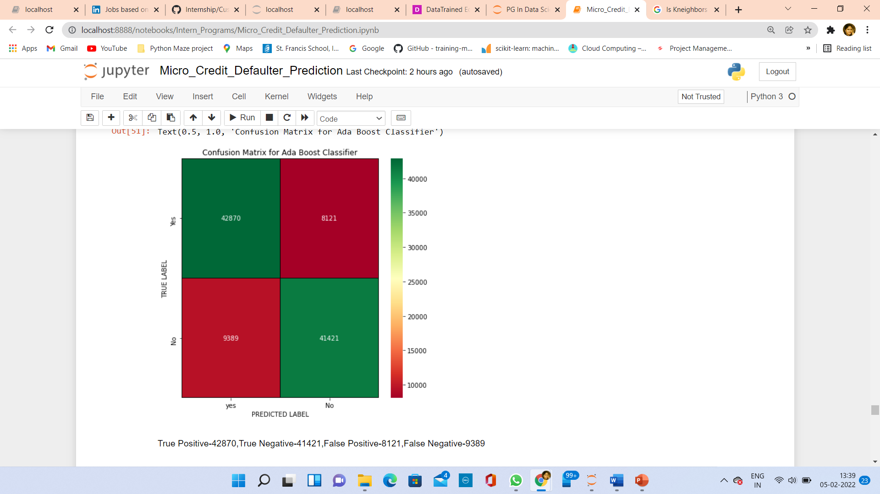
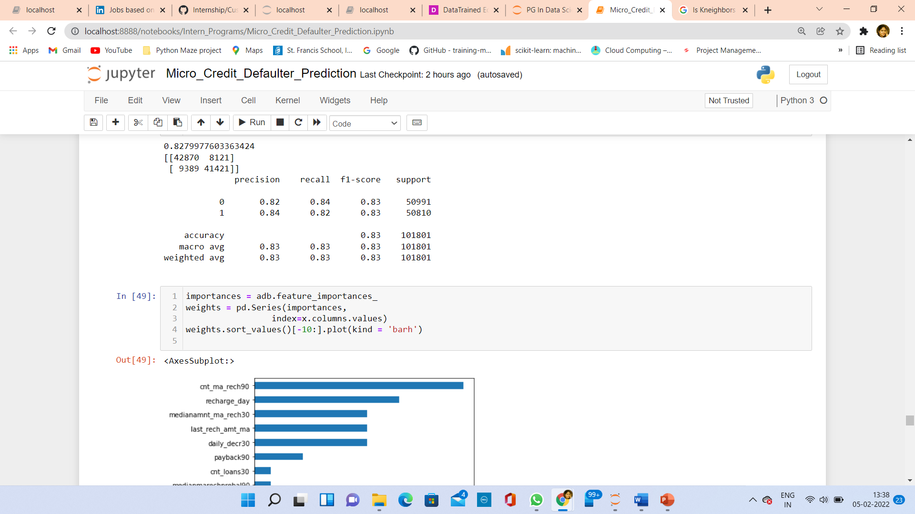
AdaBoost Classifier: Classification Report and Confusion Matrix

Slide 35
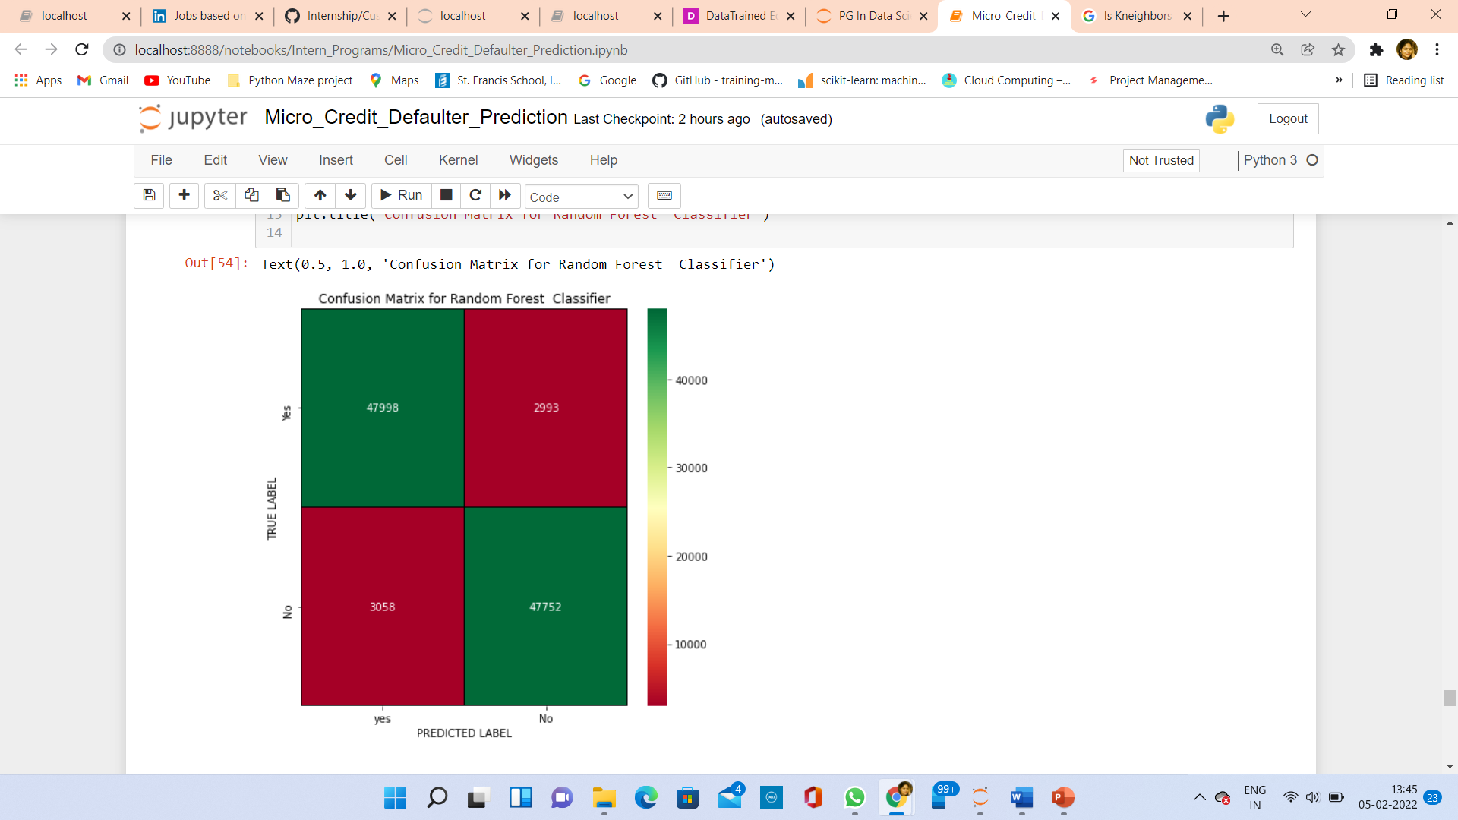
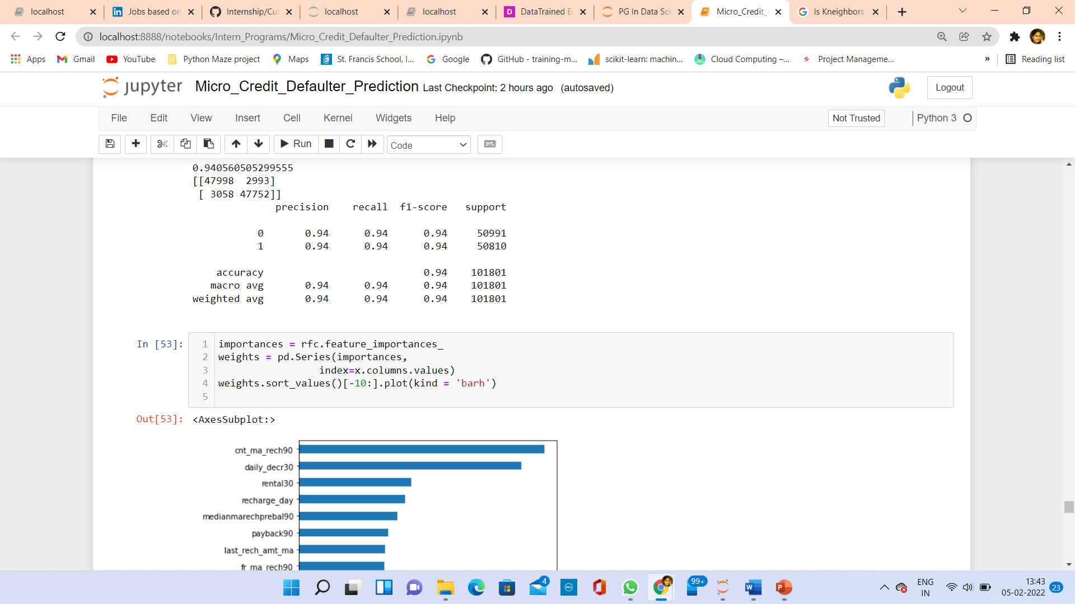
RandomForest Classifier: Classification Report and Confusion Matrix

Slide 36
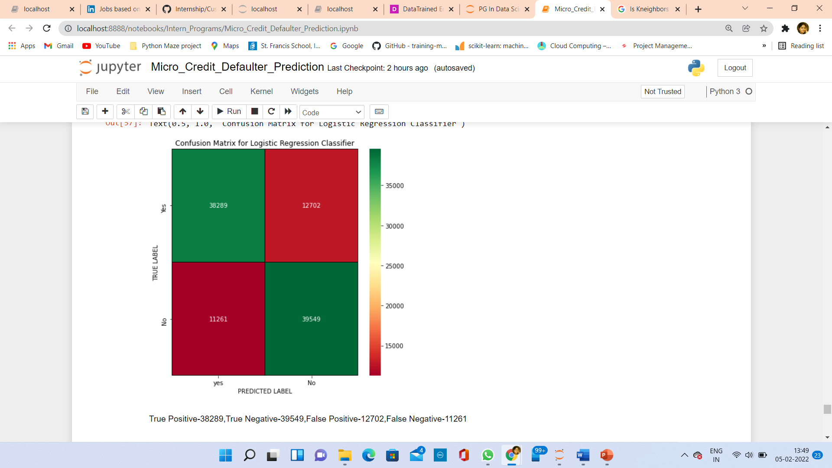
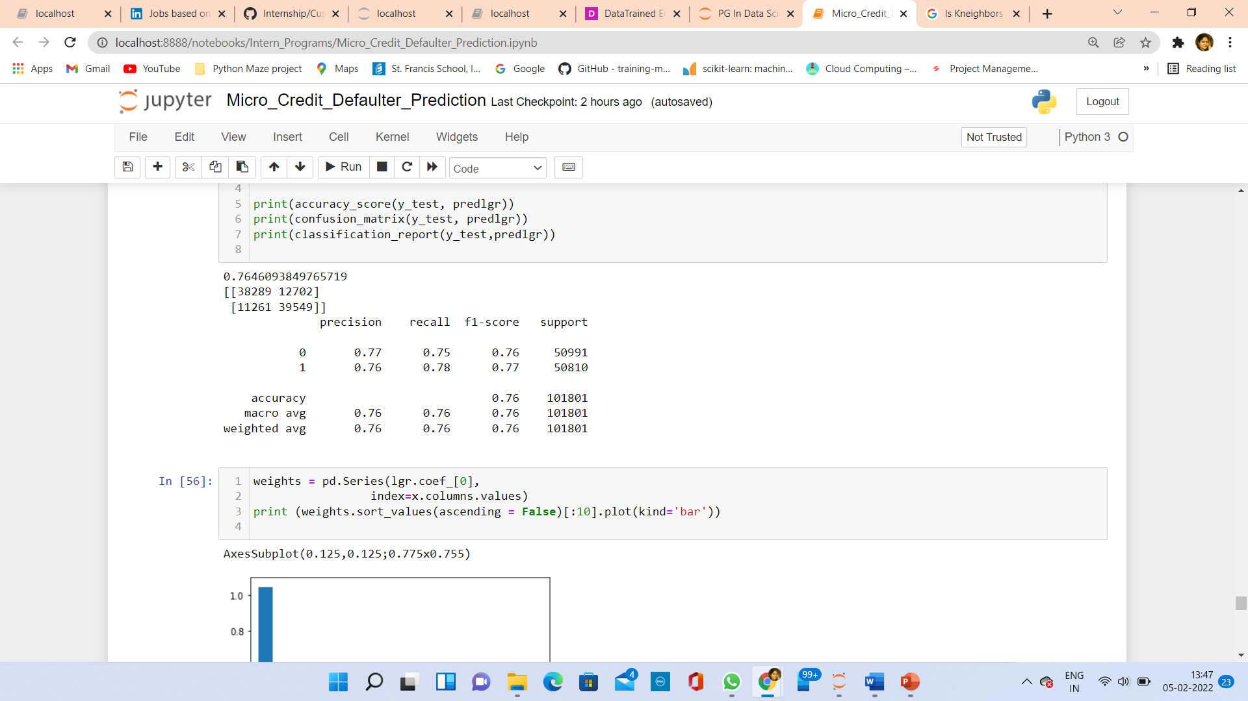
LogisticRegression Classifier: Classification Report and Confusion Matrix

Slide 37
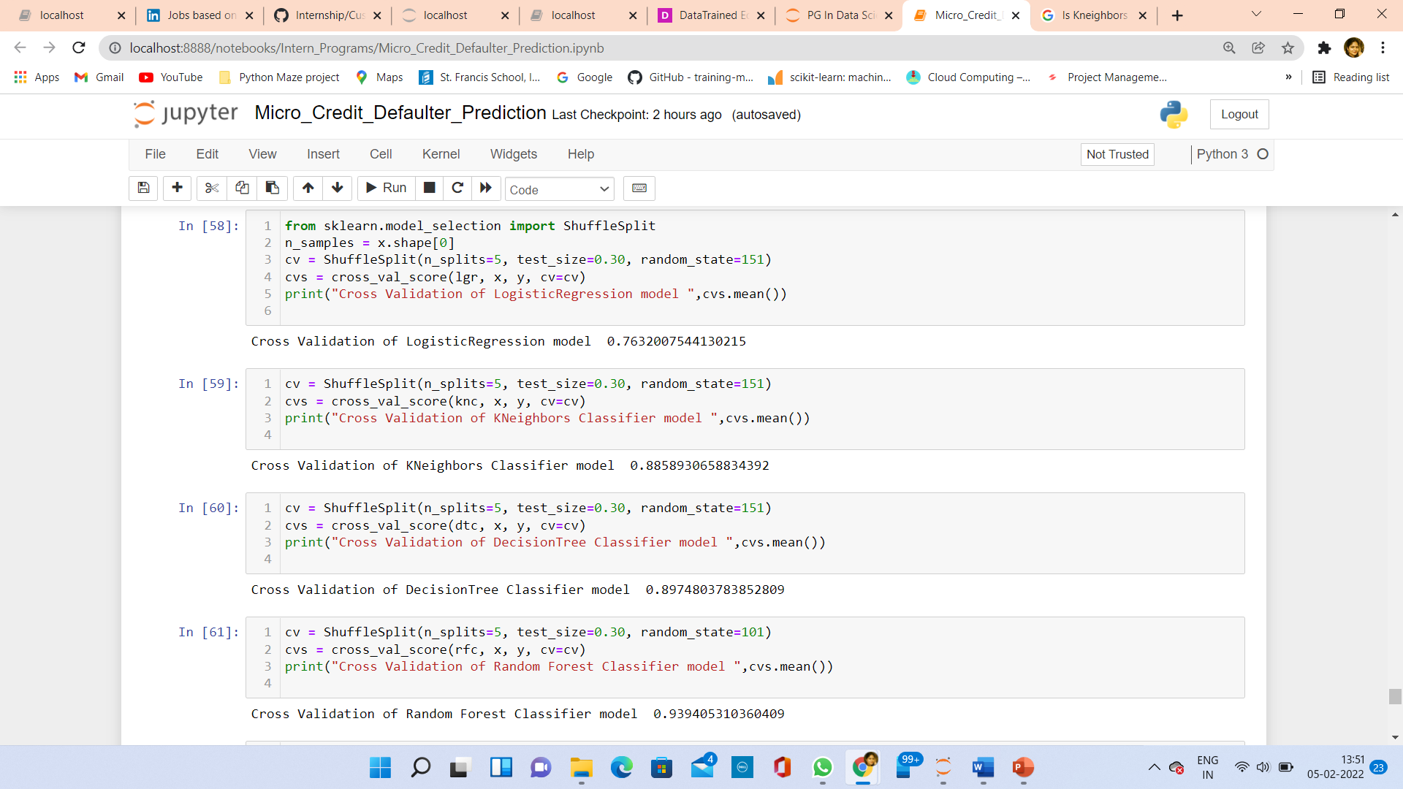
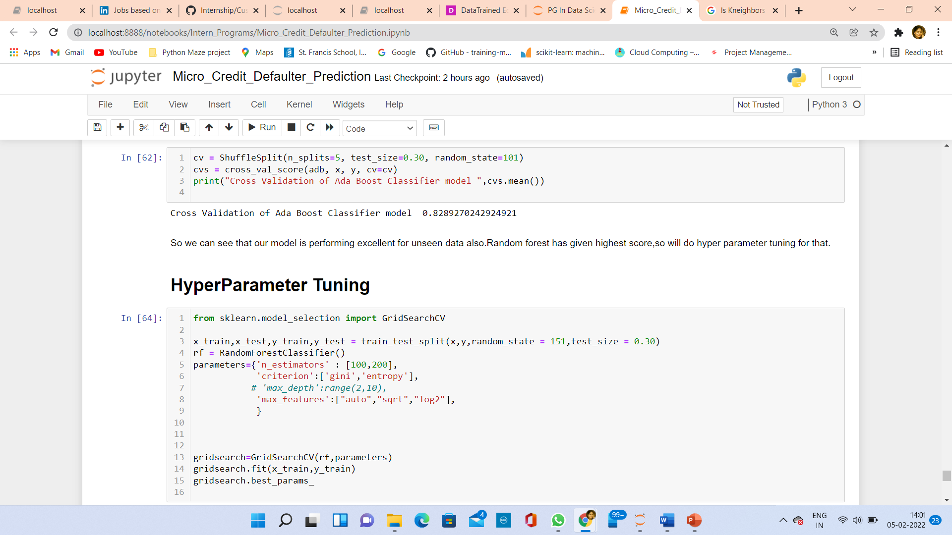
Cross Validation
Cross validation to check how are our models
Are performing on unseen data. Our model is performing well for unseen data also.
Highest score is for Random Forest, So I have done hyperparameter tuning for Random Forest .

Slide 38
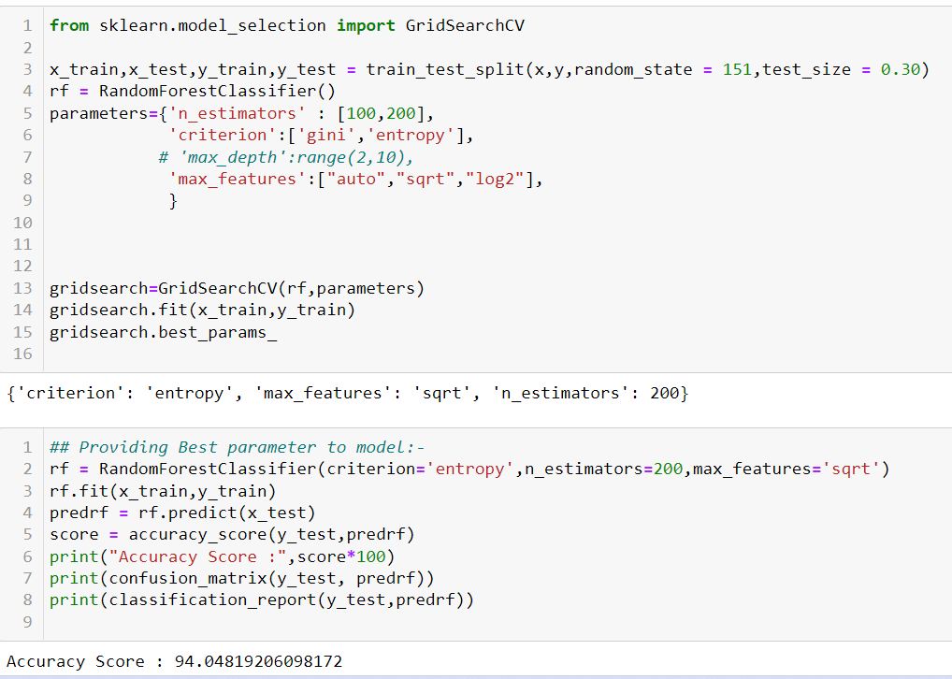
HyperParameter Tuning
After HyperParameter tuning, Score has not increased. Model is giving good result with default parameters.

Slide 39
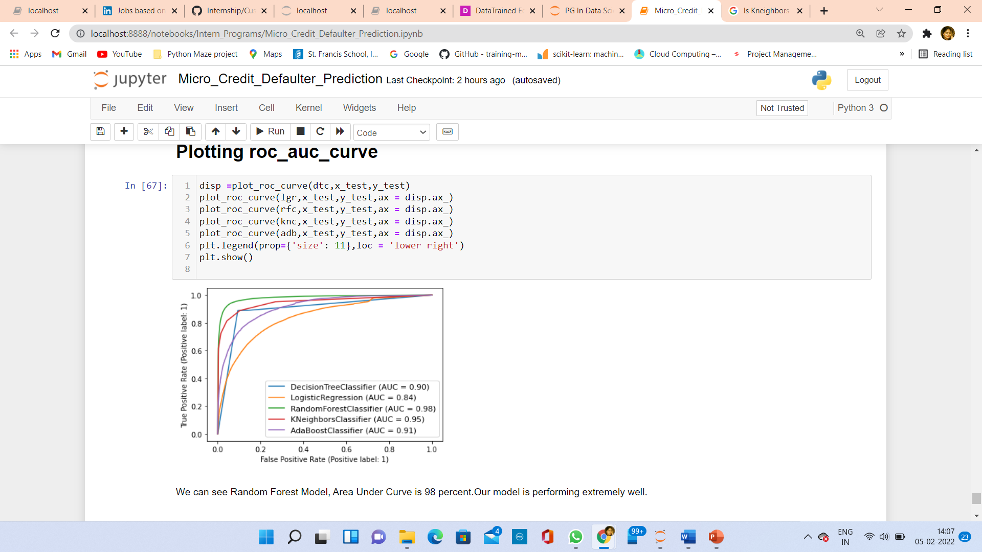
Roc Auc Curve
Area under curve is highest for Random Forest.

Slide 40
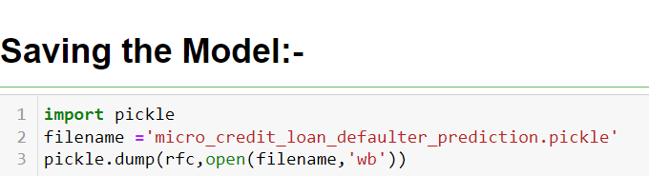
Saving Model
I have saved my model using pickle.

Slide 41
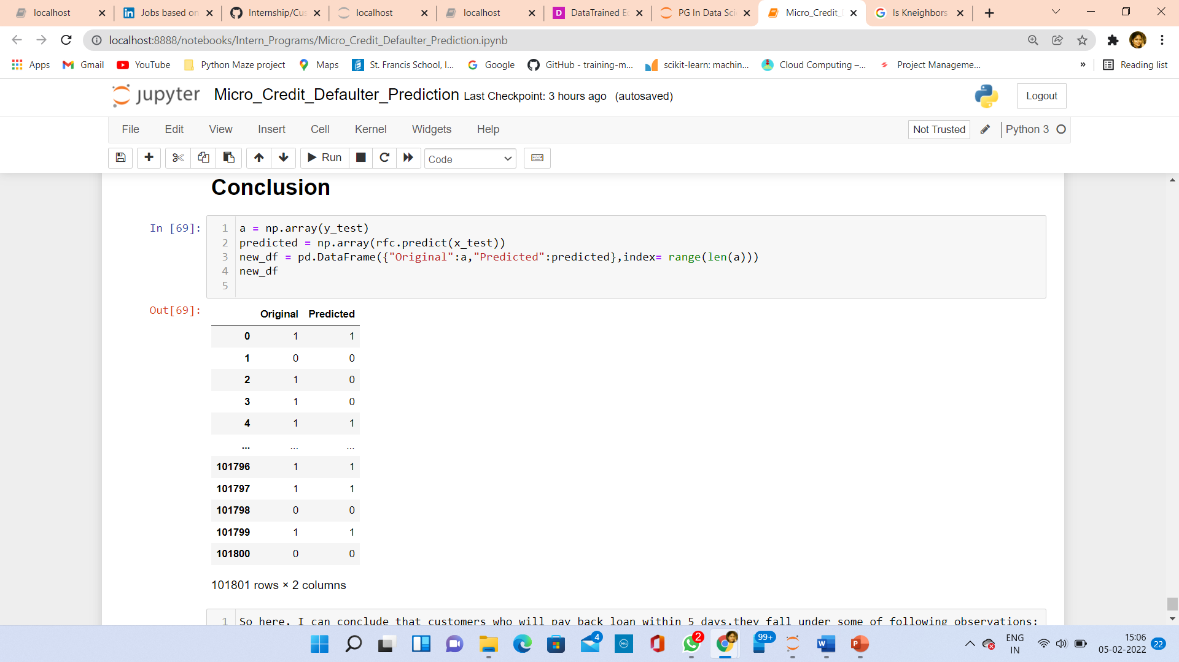
Conclusion
Conclusion is that Defaulter person less
uses services provided by Telecom service provider.

Slide 42
Limitation
Data is big in size, so, it is taking very much time to train and test.
There is scope to increase the accuracy score by tuning different hyperparameters.

